Slide 1


CCMS
Home
Service
About Us
Contact
CCMS
Court Case Management System (CCMS)
01

Slide 2
CCMS
Home
Service
About Us
Contact
ABOUT US
01
Ishtiak Ahmed Moyen(2131580642)
02
Abir Bin Faruque(2131101642)
03
Sazid Hassan(2211513042)
04
Rayhan Amin(2212830042)
02

Slide 3

CCMS
Home
Service
About Us
Contact
PROBLEM STATEMENT
The judicial system faces challenges such as delayed case processing, unorganized document handling, and inefficient courtroom scheduling due to reliance on manual processes. These issues lead to miscommunication, scheduling conflicts, and a lack of transparency, affecting the productivity of judges, lawyers, clerks, and the public. The proposed Court Case Management System (CCMS) aims to resolve these issues by providing a centralized digital platform.
03

Slide 4
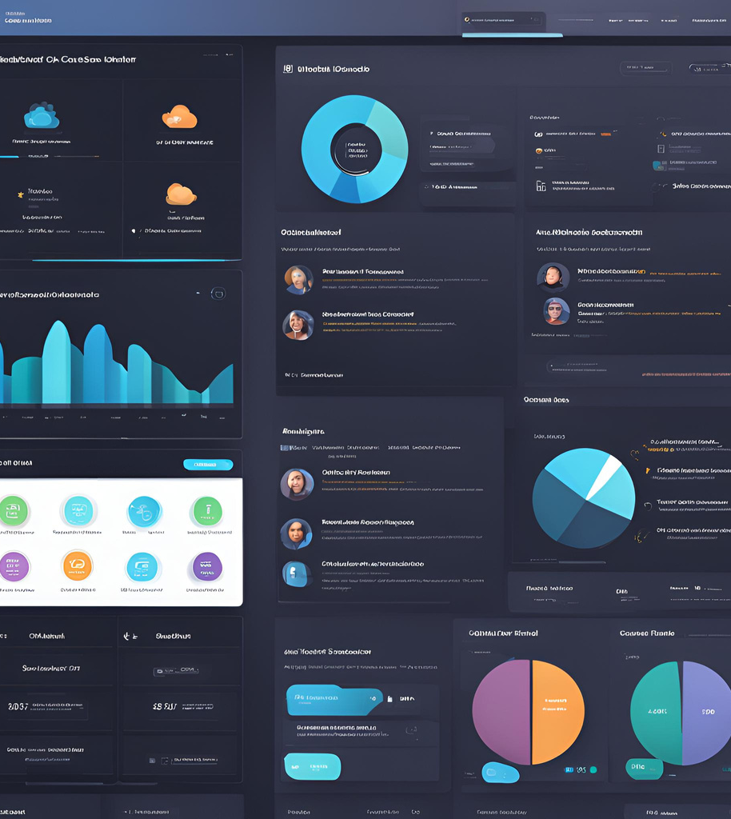
CCMS
Home
Service
About Us
Contact
VISION STATEMENT
The Court Case Management System (CCMS) is designed for judges, lawyers, clerks, and public users in the judicial system who face challenges with inefficiencies in case processing, document management, and courtroom scheduling. It is a comprehensive digital platform that streamlines judicial operations, improves transparency, and enhances coordination among stakeholders. Unlike manual processes or fragmented systems, CCMS offers a centralized, role-based solution with automated workflows, real-time updates, and secure document management, enabling a more efficient and transparent judicial ecosystem.
04

Slide 5
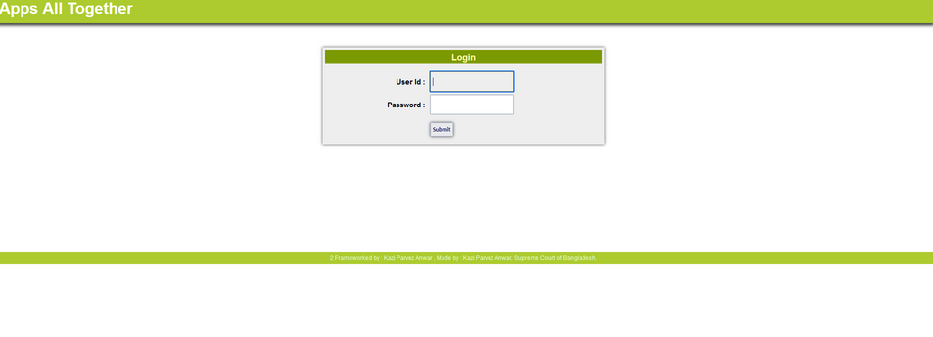
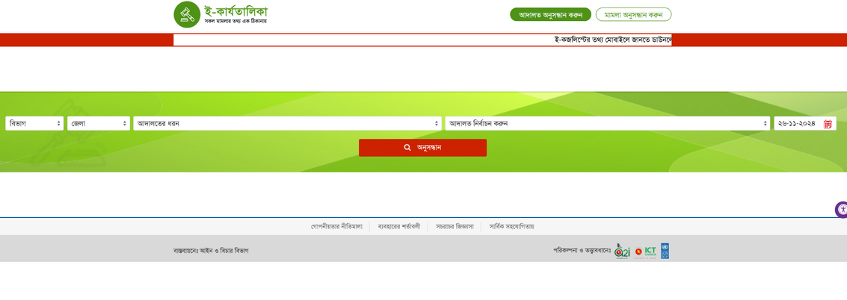
CCMS
Home
Service
About Us
Contact
EXISTING SIMILAR PLATFORMS SIMILAR
1. Supreme Court Case Management System (CMS)
2. Amar Adalat (MyCourt) Mobile App
3. Online Causelist and Judicial Monitoring Dashboard
05

Slide 6
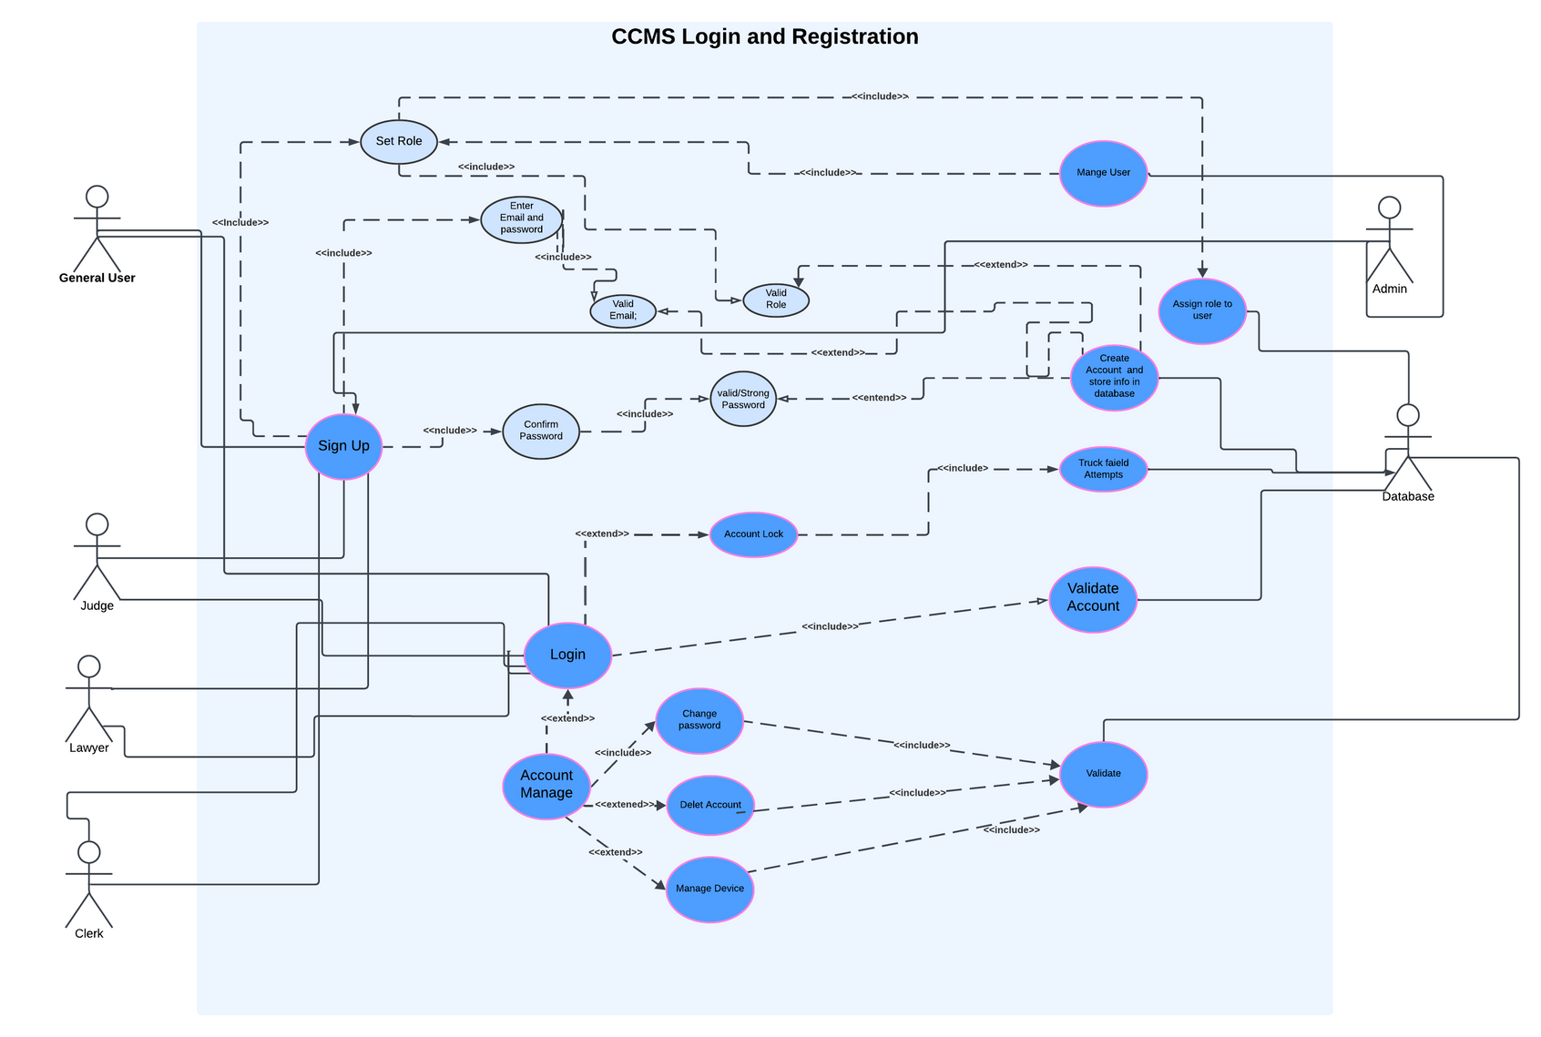
CCMS
Home
Service
About Us
Contact
USE CASE DIAGRAM
Register Page:
06

Slide 7
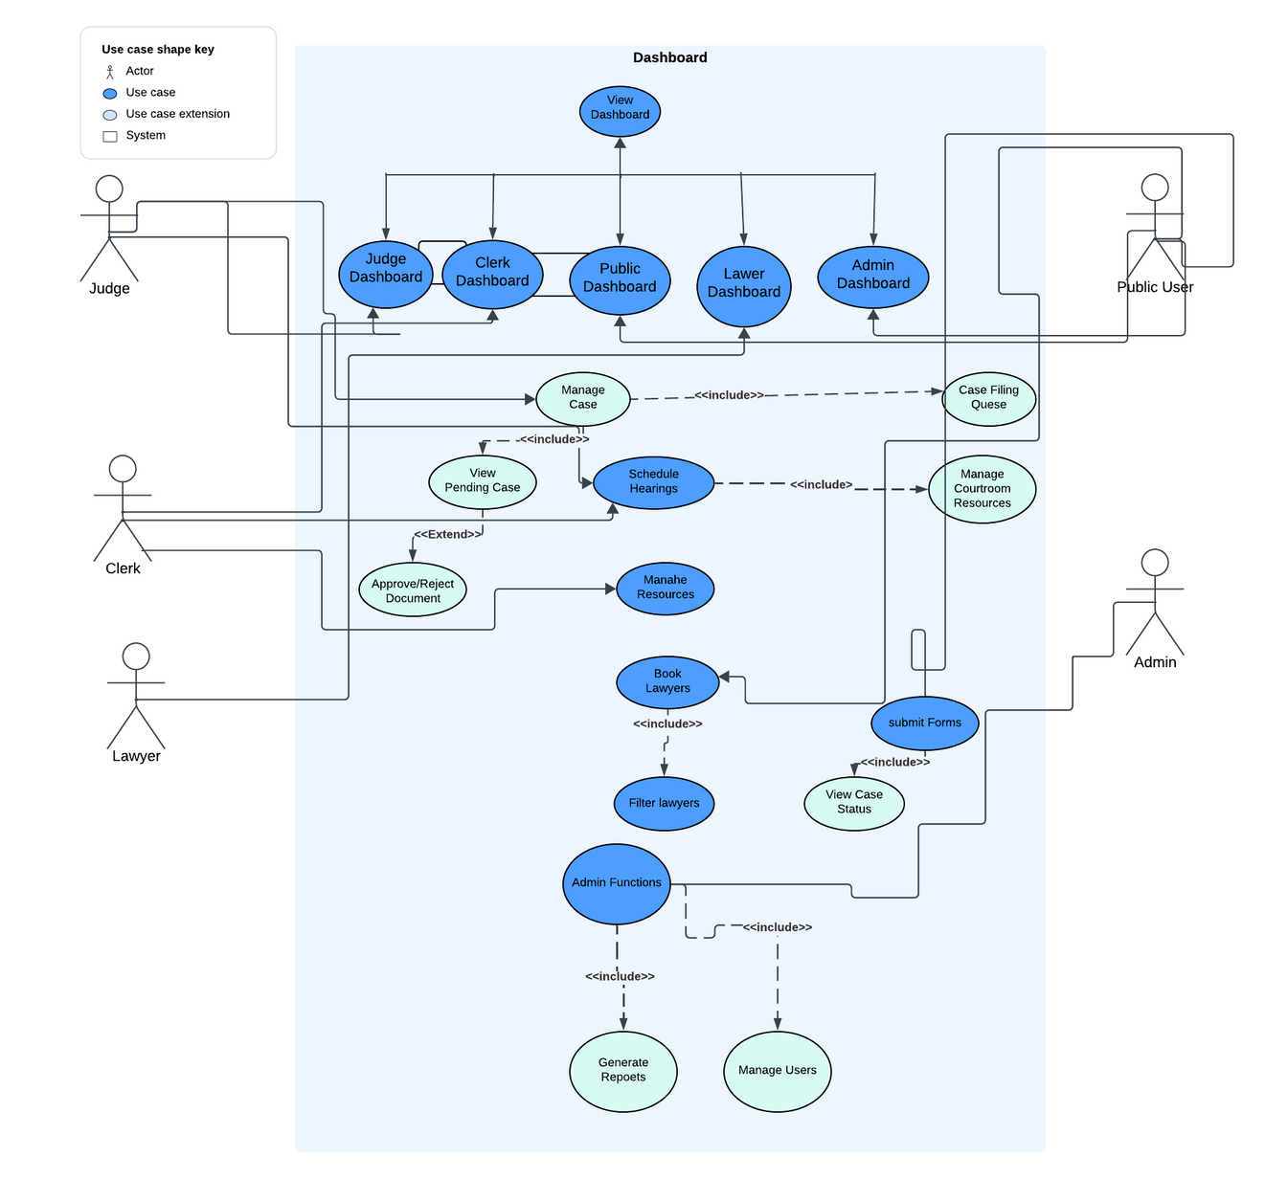
CCMS
Home
Service
About Us
Contact
Dashboard Page:
07

Slide 8
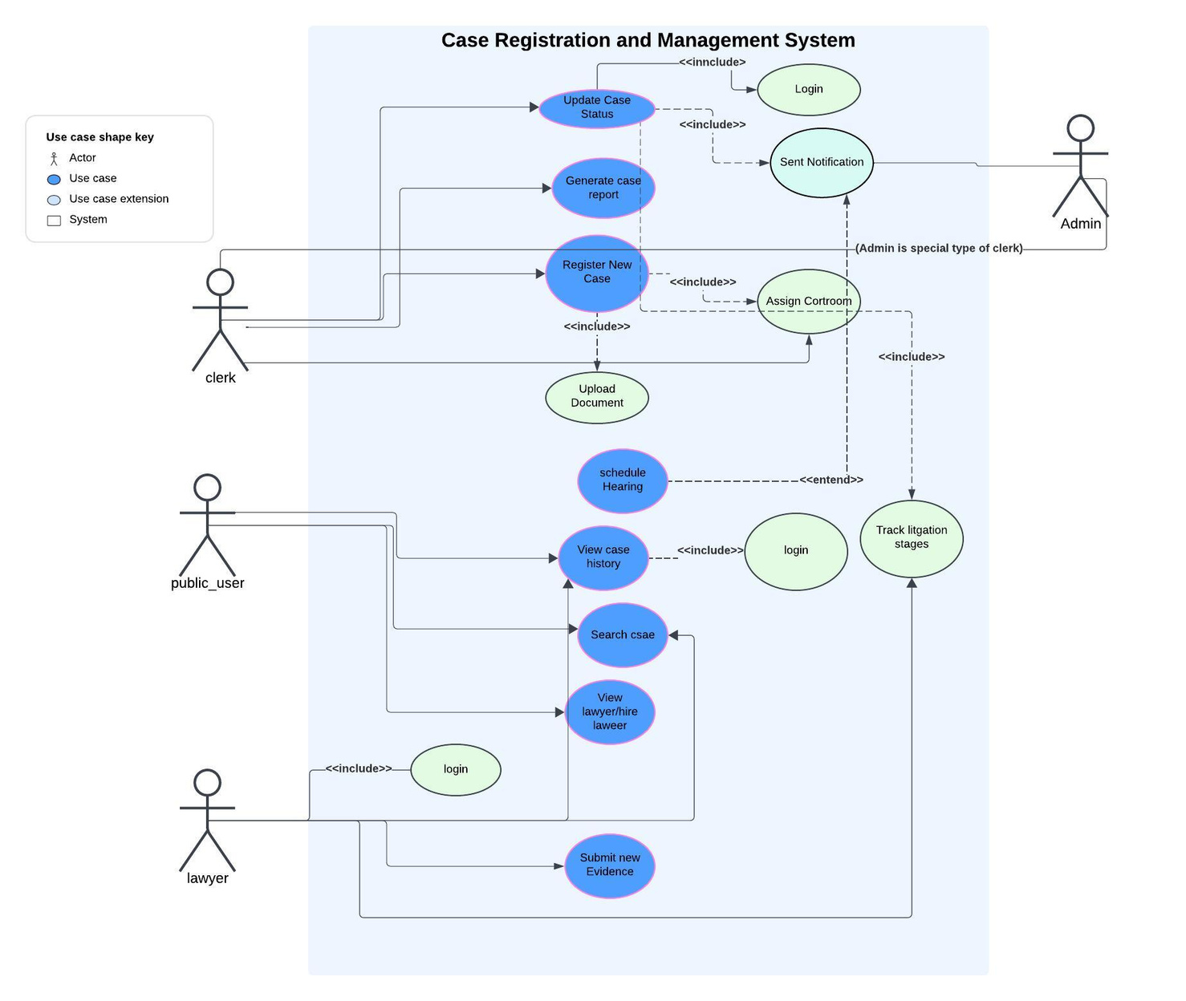
CCMS
Home
Service
About Us
Contact
Case Registration and Management System page
08

Slide 9




CCMS
Home
Service
About Us
Contact
FUNCTIONAL REQUIREMENTS FOR CCMS
01
Register and Case tracking
10
Legal database integration
02
10
Crime search tools
Document e-filing
03
Role-based access
Automated reminders
12
04
Courtroom automation
Court order tracking
13
05
Dashboards & reports
12
Secure backups
13
Bulk document handling
06
Public access porta
14
Punishment estimation
07
Crime search tools
08
Lawyer booking
Fee management
09
09

Slide 10



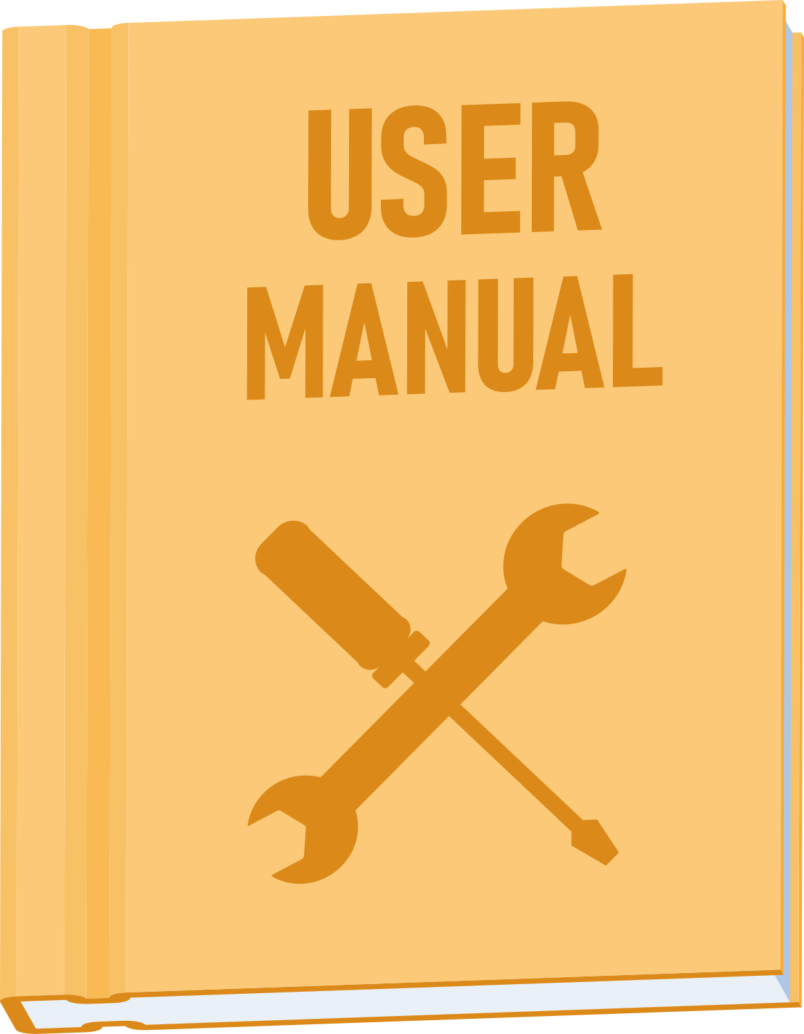
CCMS
Home
Service
About Us
Contact
NON-FUNCTIONAL REQUIREMENTS FOR CCMS
01
Support 500 users
10
Future scalability
02
<2s response time
03
99.9% uptime
04
Secure login (MFA)
05
Regular security audits
06
User-friendly design
07
Clear navigation/help
08
Maintenance guides
Data protection
10
09

Slide 11
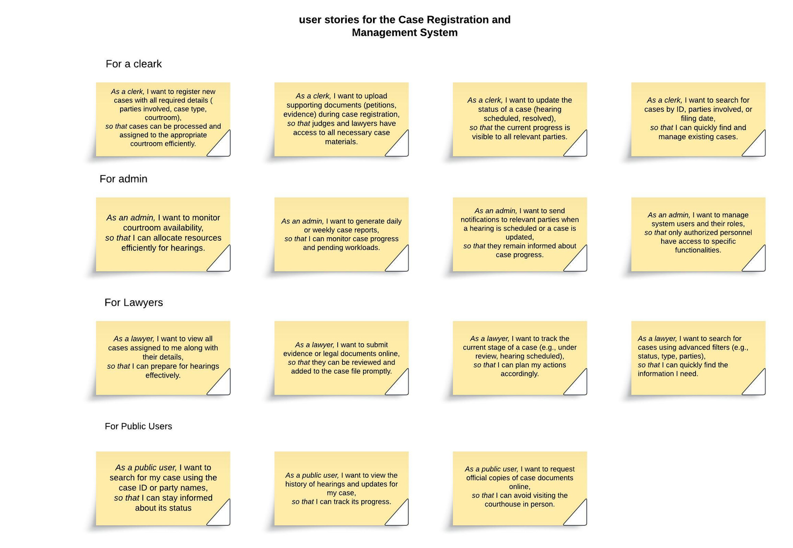
CCMS
Home
Service
About Us
Contact
User Story
For Registration and Login page
11

Slide 12
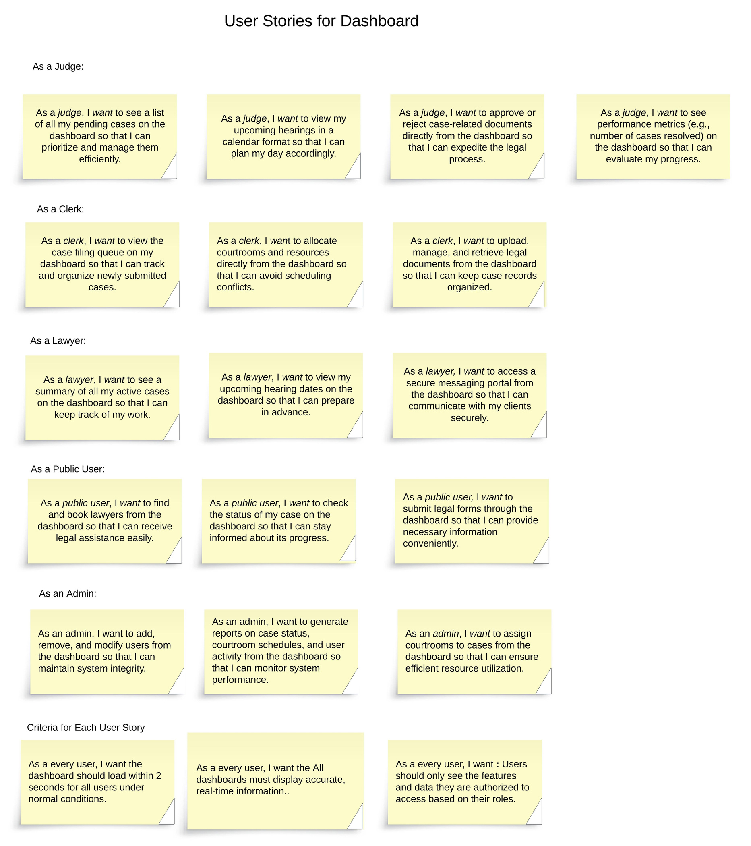
CCMS
Home
Service
About Us
Contact
User Story
User Story For Dashbord
12

Slide 13
CCMS
Home
Service
About Us
Contact
User Story
User Story For Case Registration and Management
13

Slide 14
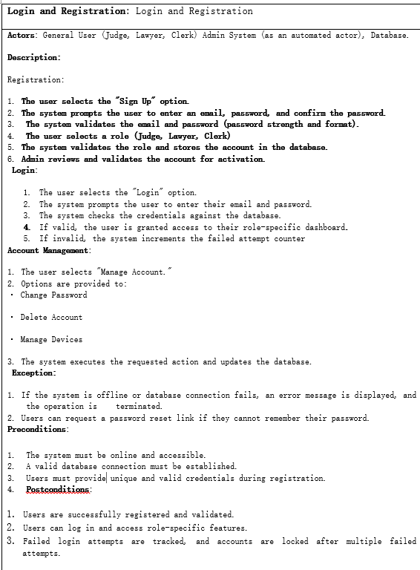
CCMS
USE CASE SPECIFICATION
Home
Service
About Us
Contact
14

Slide 15
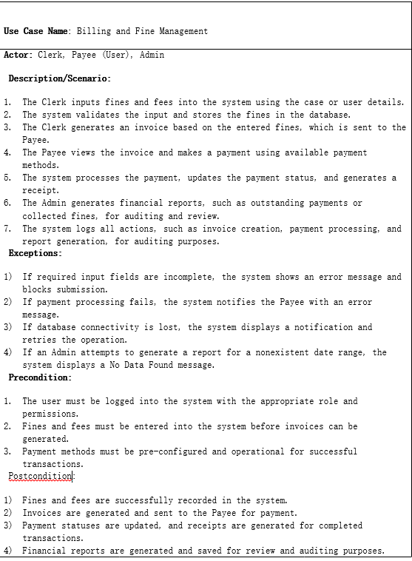
CCMS
USE CASE SPECIFICATION
Home
Service
About Us
Contact
15

Slide 16
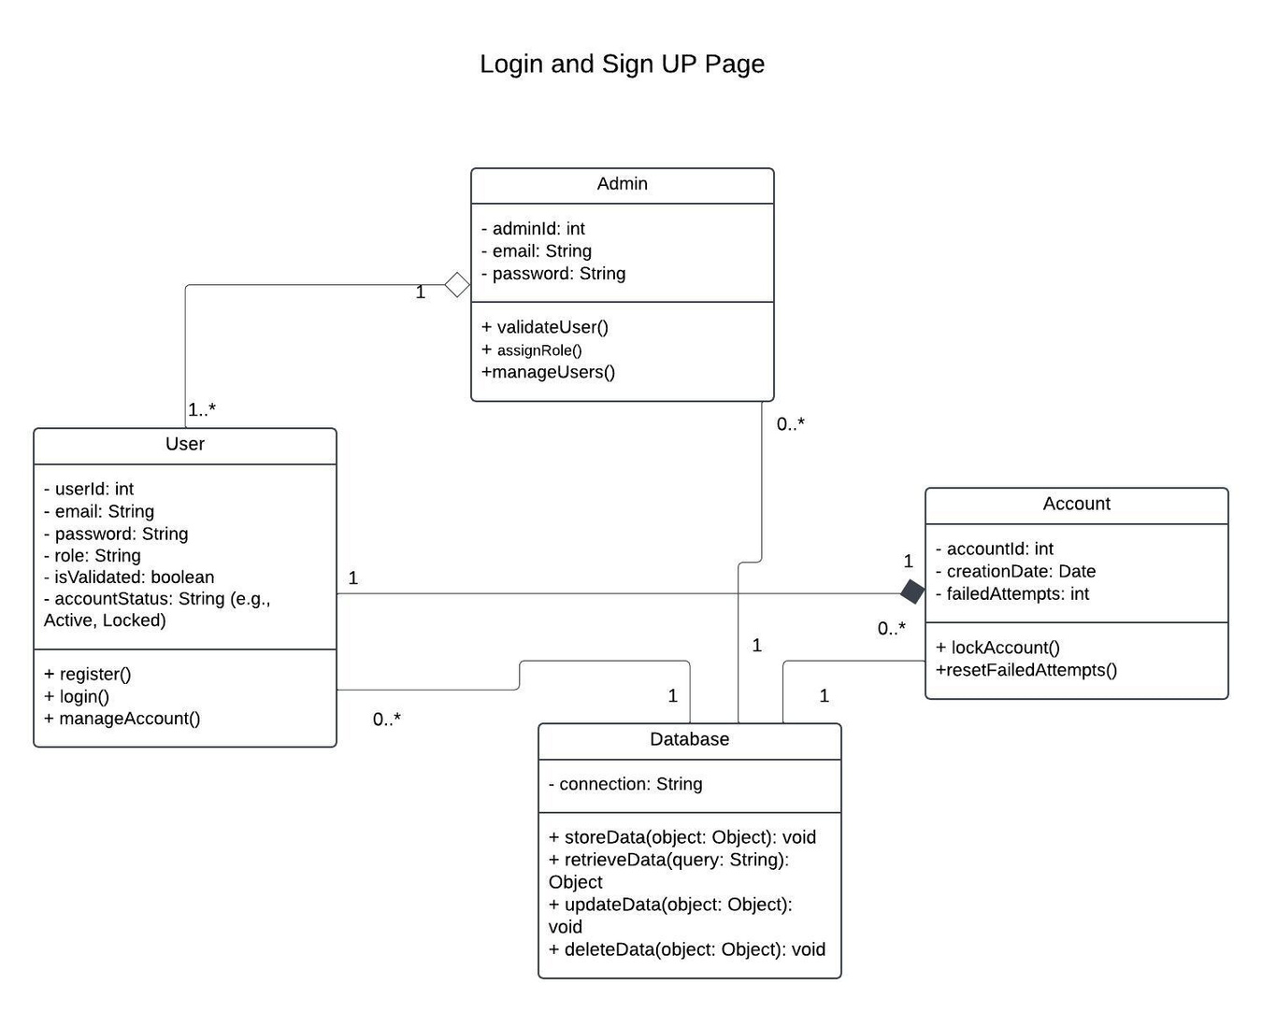
Class Diagram
CCMS
Home
Service
About Us
Contact
16

Slide 17
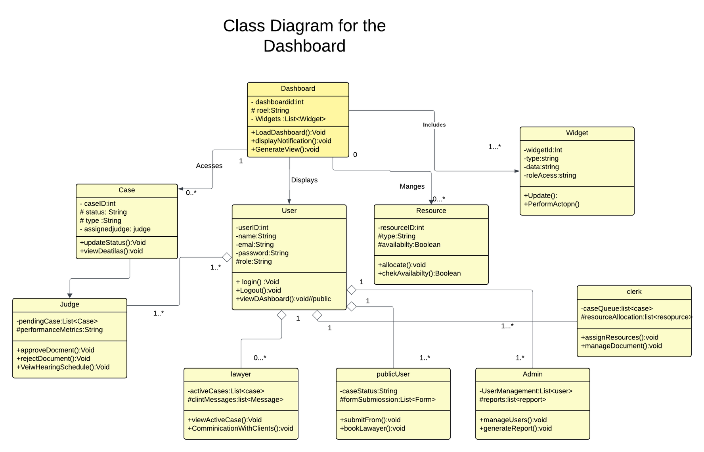
Class Diagram
CCMS
Home
Service
About Us
Contact
17

Slide 18
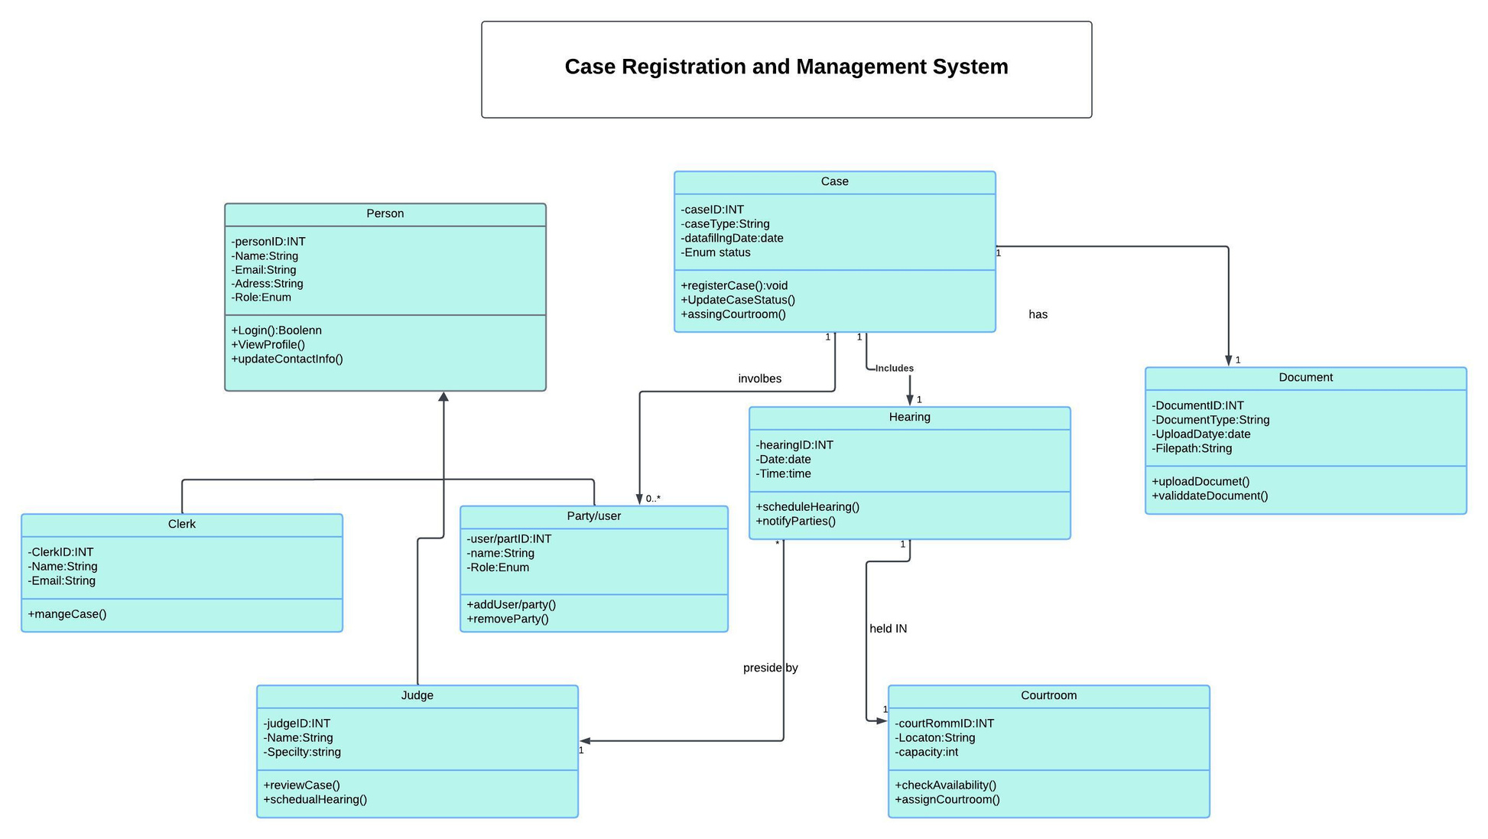
Class Diagram
CCMS
Home
Service
About Us
Contact
18

Slide 19
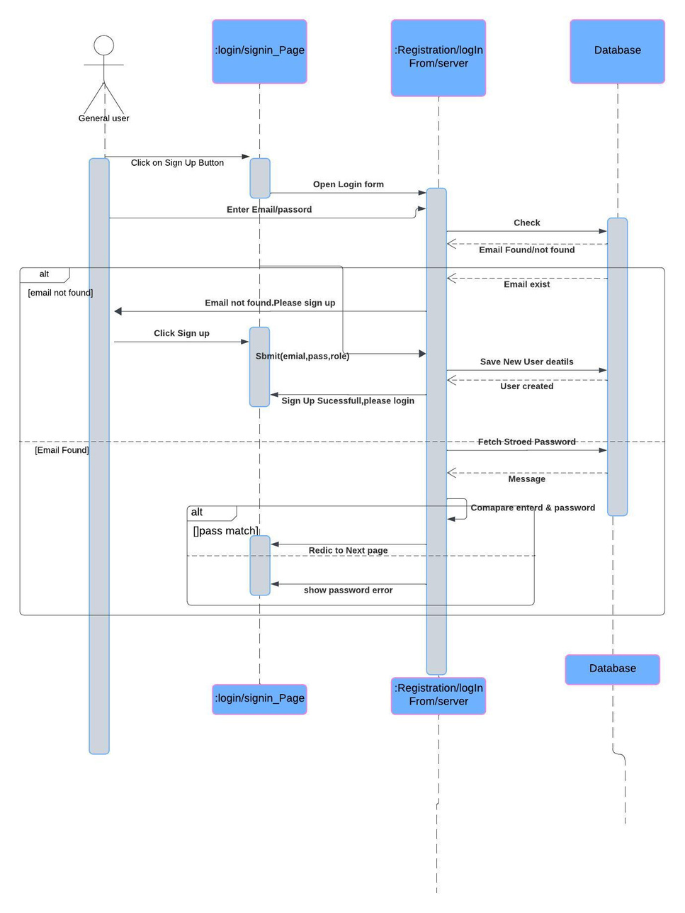
Sequence Diagram
CCMS
Home
Service
About Us
Contact
Login and Registration
19

Slide 20
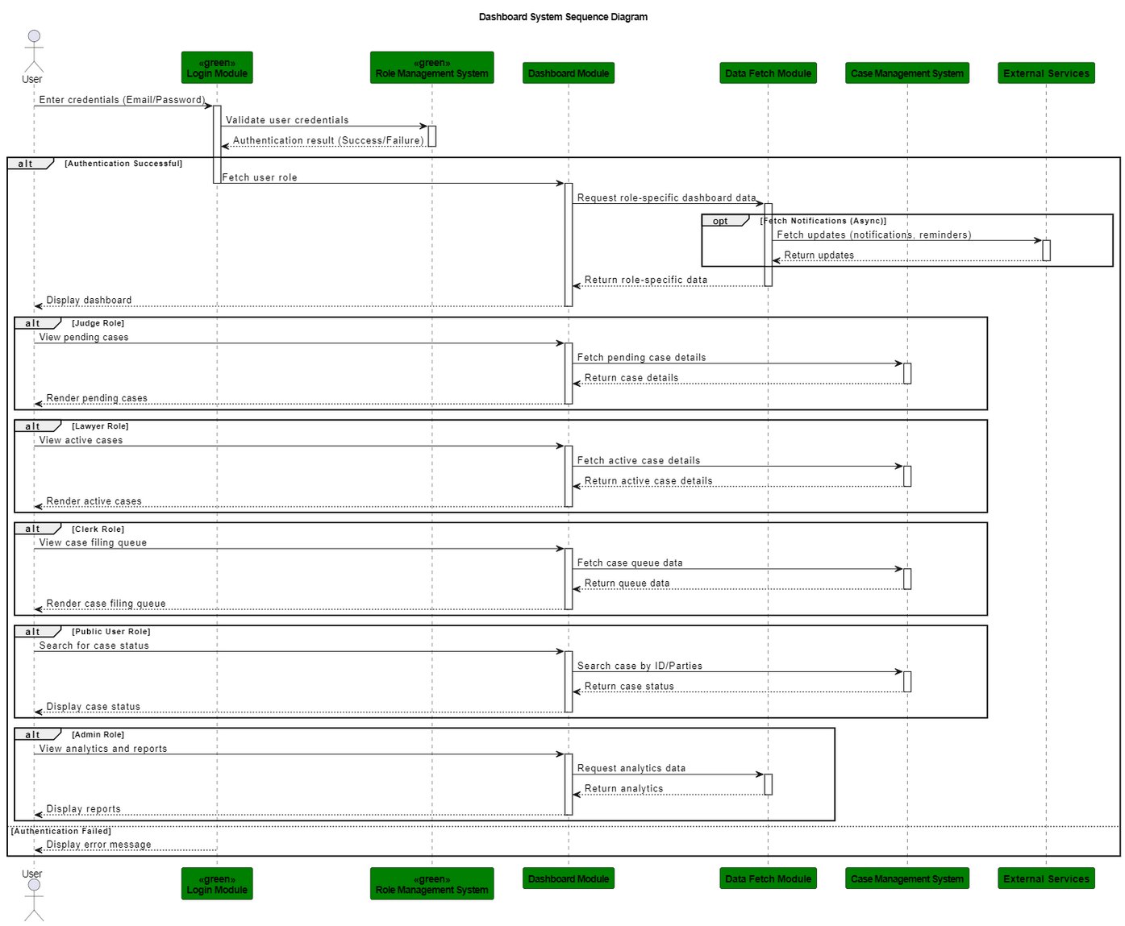
Sequence Diagram
CCMS
Home
Service
About Us
Contact
DashBoard
20

Slide 21
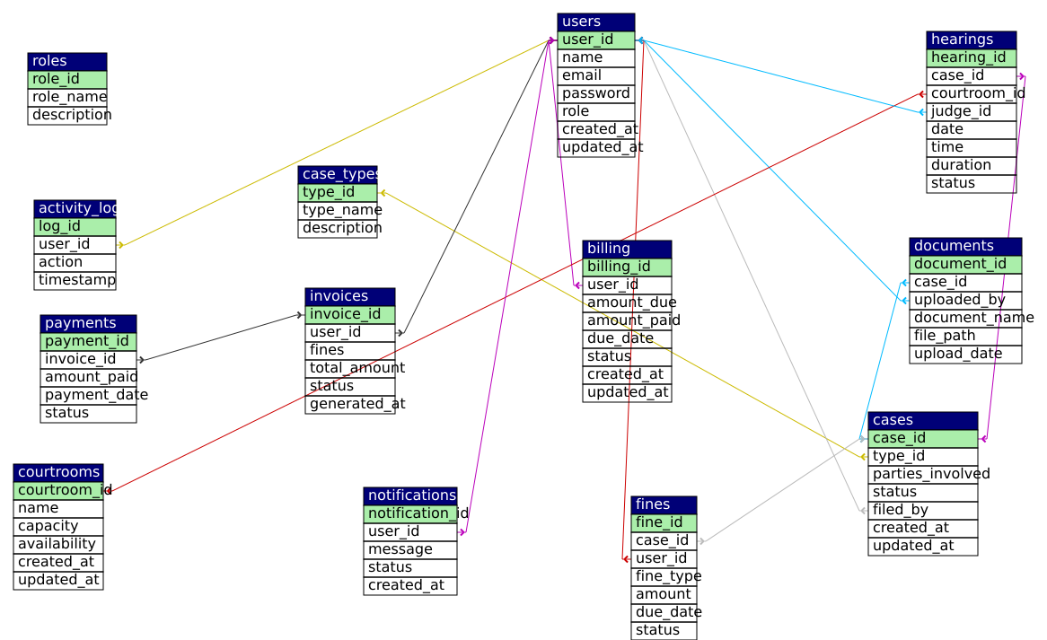
CCMS
DATABASE SCHEMA
Home
Service
About Us
Contact
21

Slide 22

CCMS
Any Question ?
22

Slide 23
CCMS
Thank You !
23

